Slide 1




Towards a General-Purpose Model
for Quantum Many-Body Problems
Yuan-Hang Zhang
Y.-H. Zhang and M. Di Ventra
Phys. Rev. B 107, 075147 (2023)

Slide 2
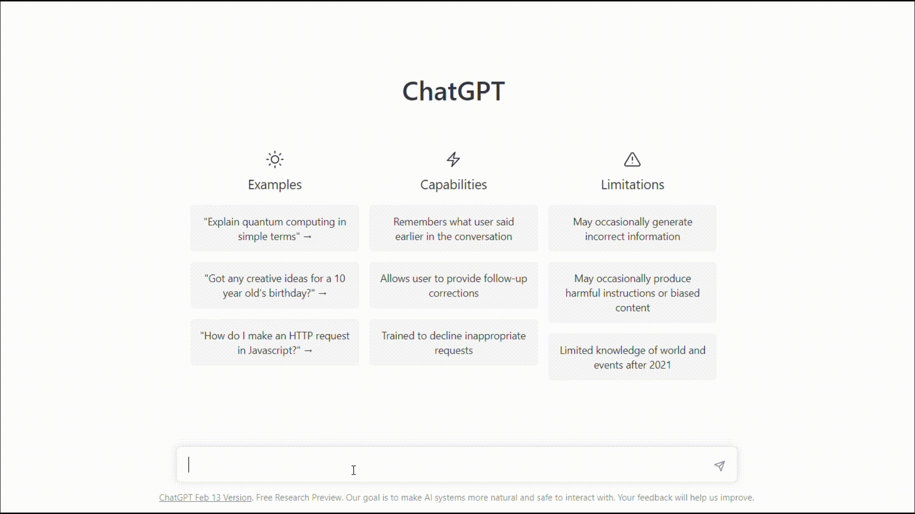

Slide 3






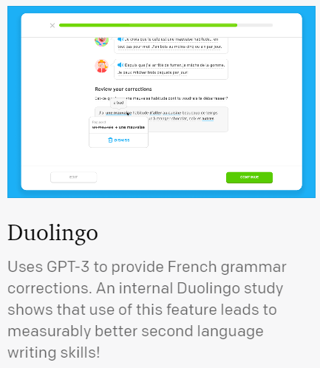


General purpose language model
$$⋯$$
Fine- tuning
Books
ChatGPT
45 TB text data
Code Generation
Pre-training
Study Partner
175 Billion Parameters
$$⋯⋯$$
Brown, Tom, et al. "Language models are few-shot learners." Advances in neural information processing systems 33 (2020): 1877-1901.

Slide 4


General purpose physics model?
Various Hamiltonians
Fine- tuning
New materials
Ground States
Pre-training
Excited States
Quantum Simulation
Open Systems
Quantum Dynamics
Quantum Tomography
Quantum Circuits
$$⋯⋯$$
$$⋯⋯$$

Slide 5
Transformer quantum state
Phase Diagram
Family of Hamiltonians
Pre-training
Finite-size Scaling
Parameter Prediction
$$⋯⋯$$

Slide 6
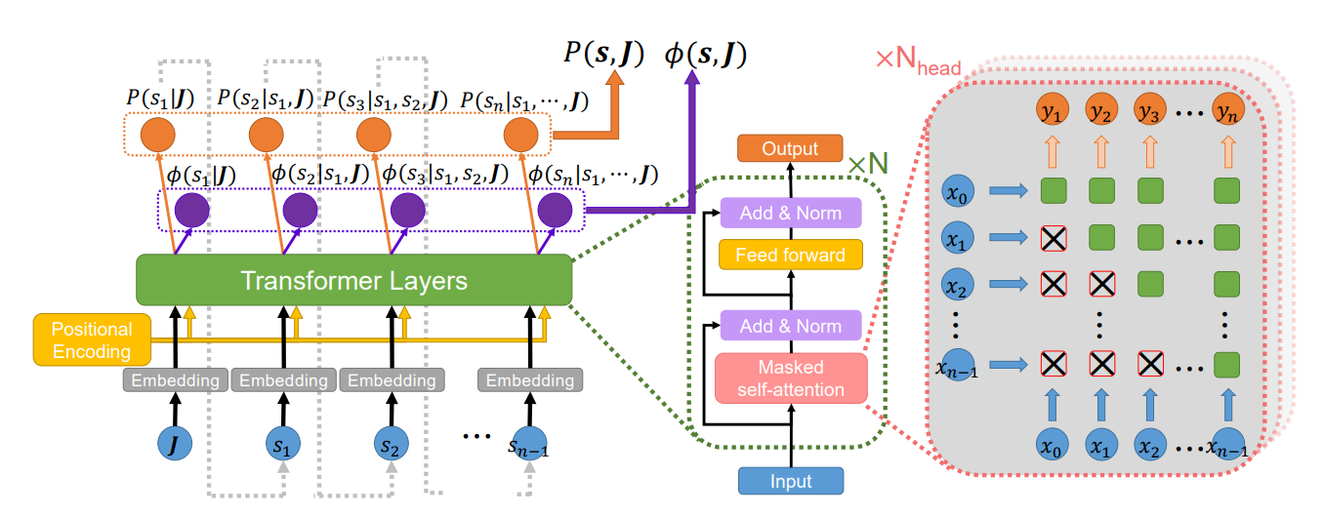
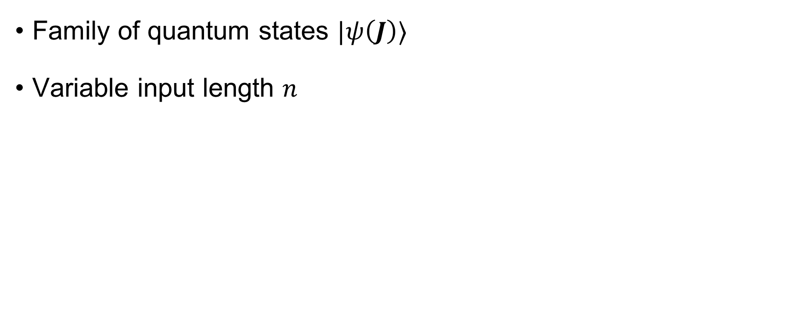
Transformer quantum state
Family of quantum states $|ψ\left(J\right)⟩$
Variable input length $n$

Slide 7
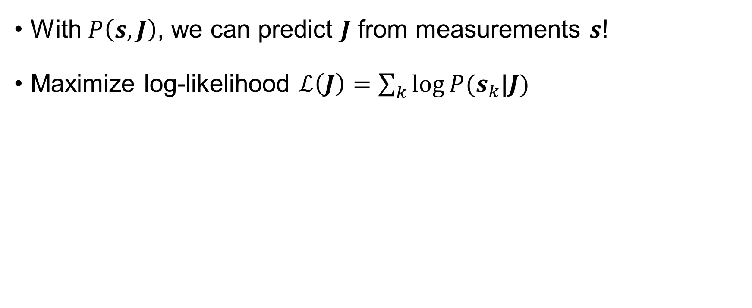
Transformer quantum state
With $P\left(s, J\right)$, we can predict $J$ from measurements $s$!
Maximize log-likelihood $ℒ\left(J\right)=\sum_{k}{\log{P(s_{k}|J)}}$

Slide 8
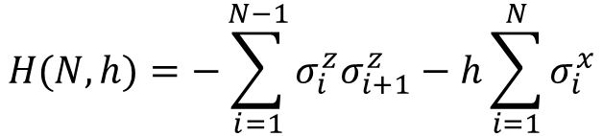
Transformer quantum state
Example: transverse field Ising model
$$H(N, h)=−\sum_{i=1}^{N−1}{σ_{i}^{z}σ_{i+1}^{z}}−h\sum_{i=1}^{N}{σ_{i}^{x}}$$

Slide 9
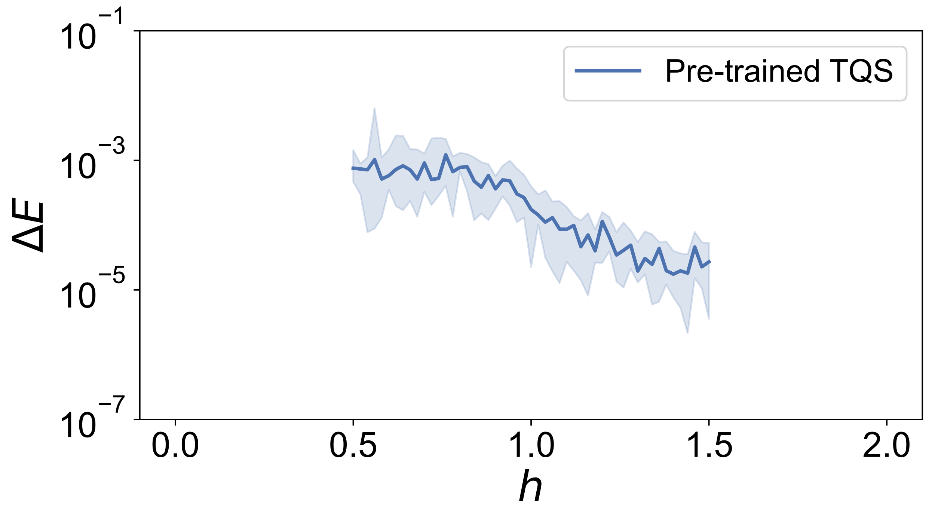
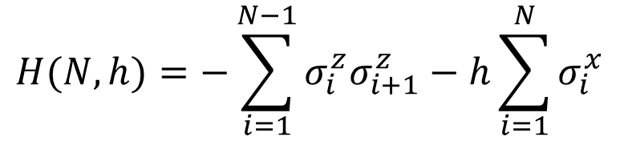
Transformer quantum state
$$H(N, h)=−\sum_{i=1}^{N−1}{σ_{i}^{z}σ_{i+1}^{z}}−h\sum_{i=1}^{N}{σ_{i}^{x}}$$

Slide 10
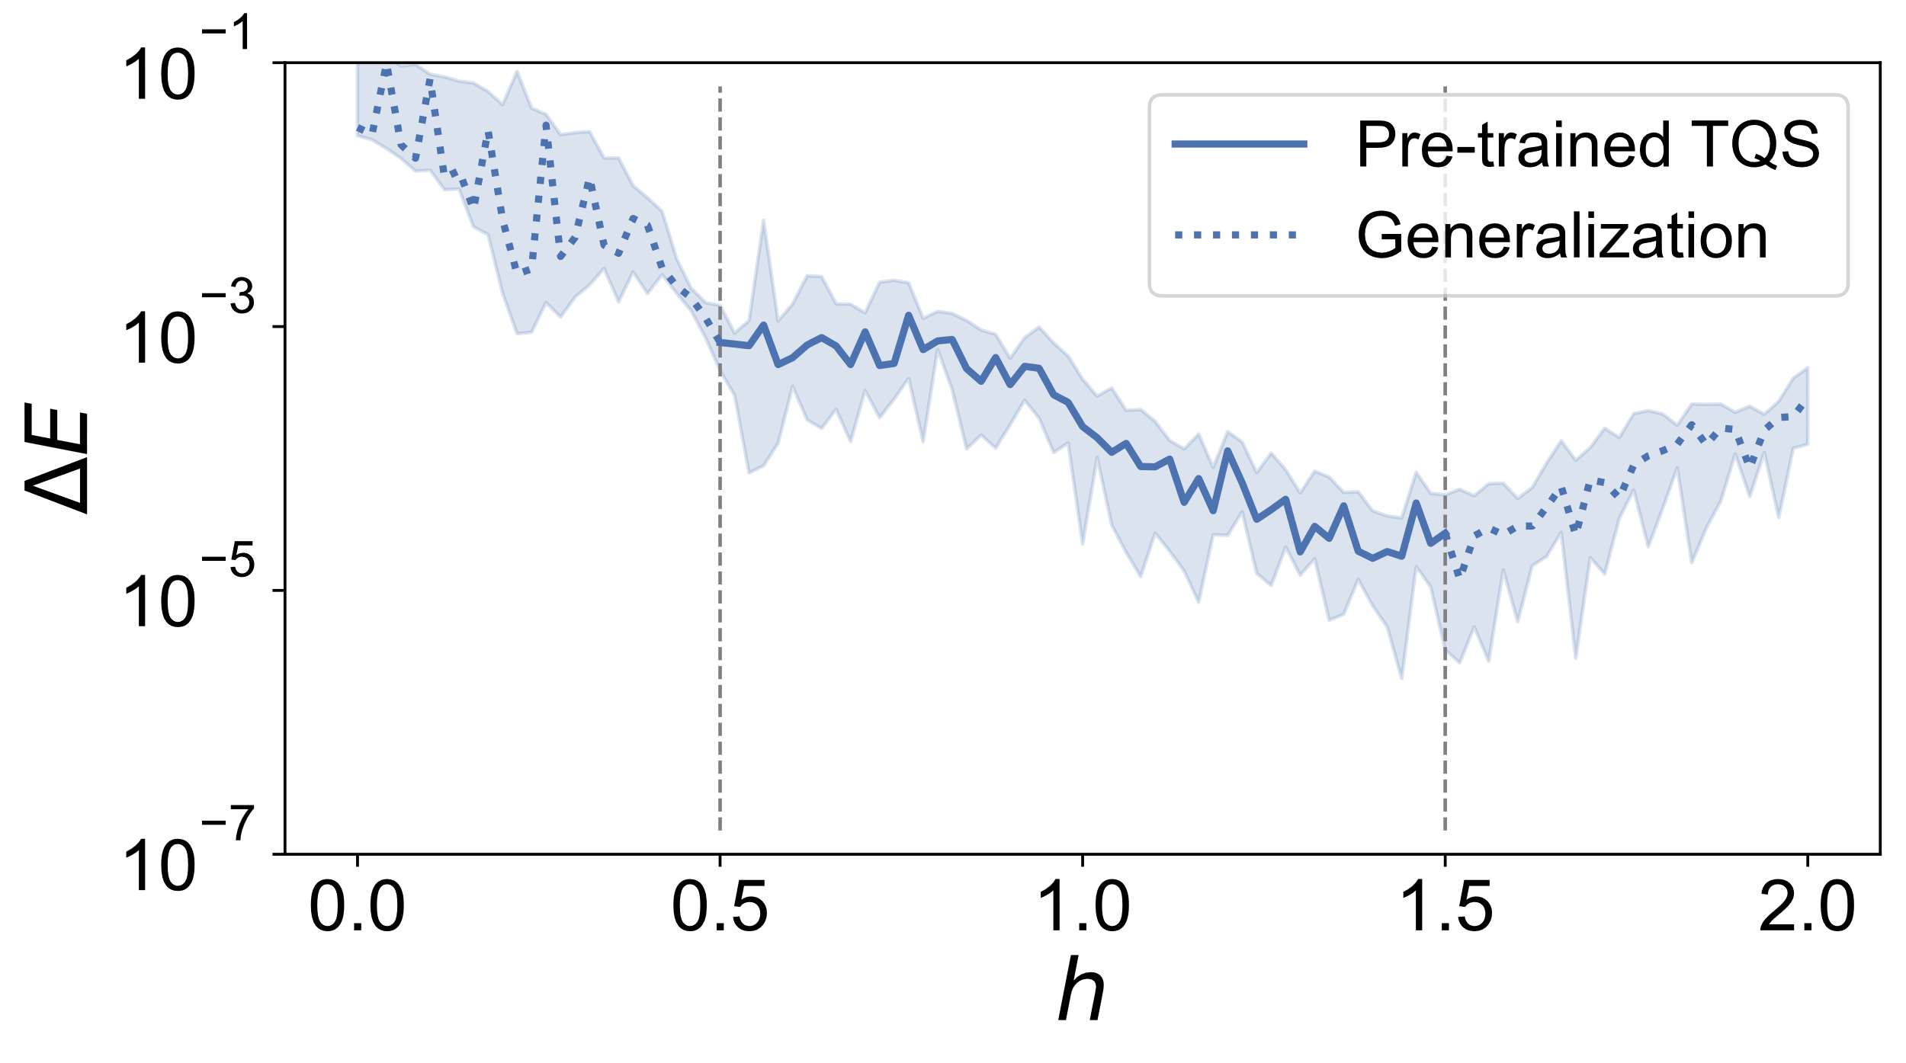
Transformer quantum state
$$H(N, h)=−\sum_{i=1}^{N−1}{σ_{i}^{z}σ_{i+1}^{z}}−h\sum_{i=1}^{N}{σ_{i}^{x}}$$

Slide 11
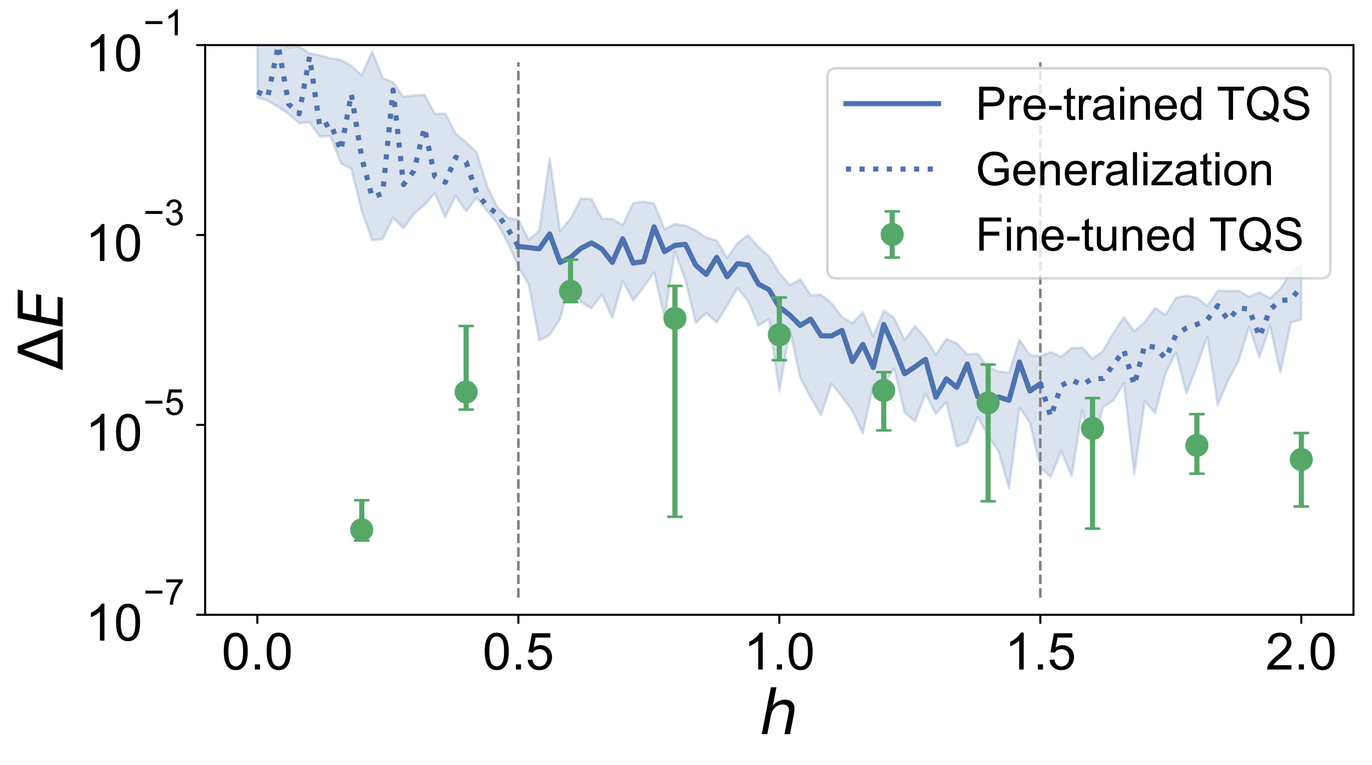
Transformer quantum state
$$H(N, h)=−\sum_{i=1}^{N−1}{σ_{i}^{z}σ_{i+1}^{z}}−h\sum_{i=1}^{N}{σ_{i}^{x}}$$

Slide 12
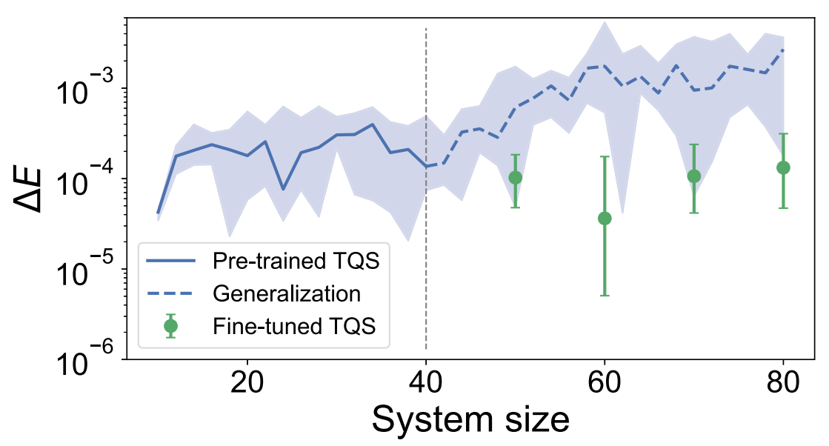
Transformer quantum state
$$H(N, h)=−\sum_{i=1}^{N−1}{σ_{i}^{z}σ_{i+1}^{z}}−h\sum_{i=1}^{N}{σ_{i}^{x}}$$

Slide 13
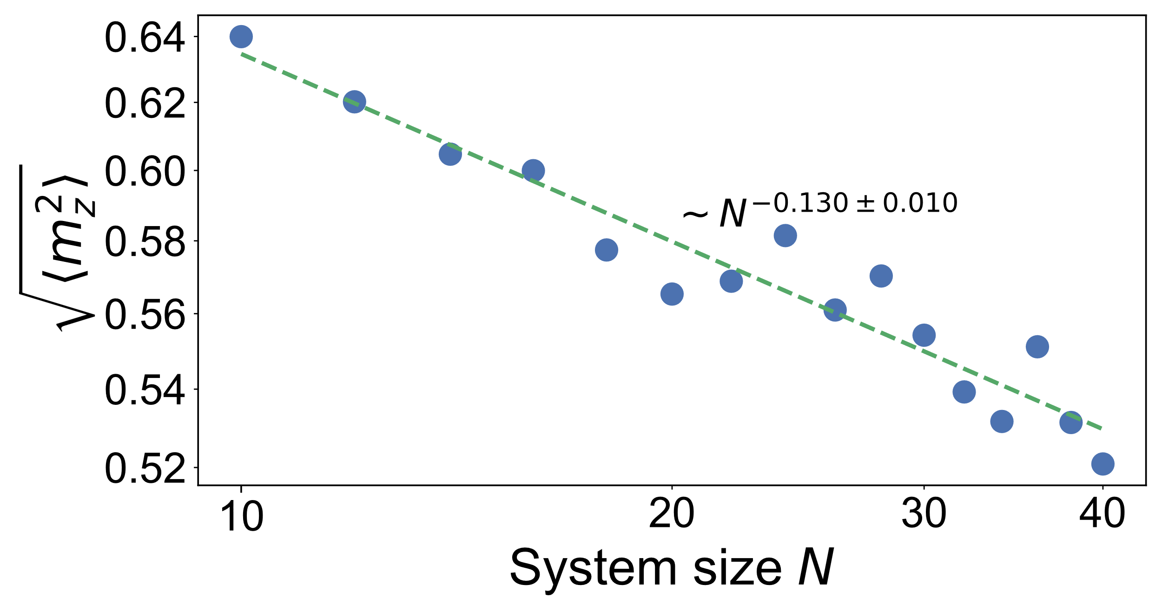
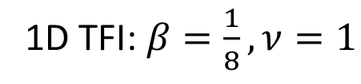
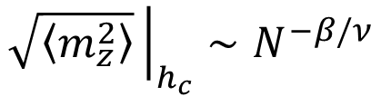
Finite-size scaling
$$\sqrt{\left\langle m_{z}^{2}\right\rangle }{\left.​\right|}_{h_{c}}∼N^{−β/ν}$$
1D TFI: $β=\frac{1}{8},ν=1$

Slide 14
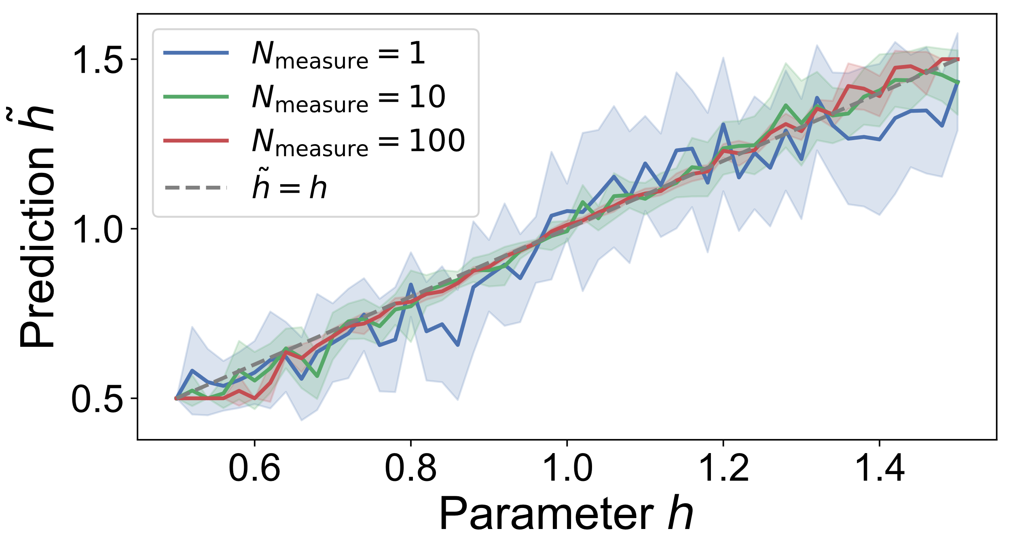
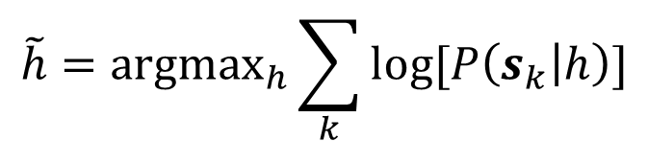
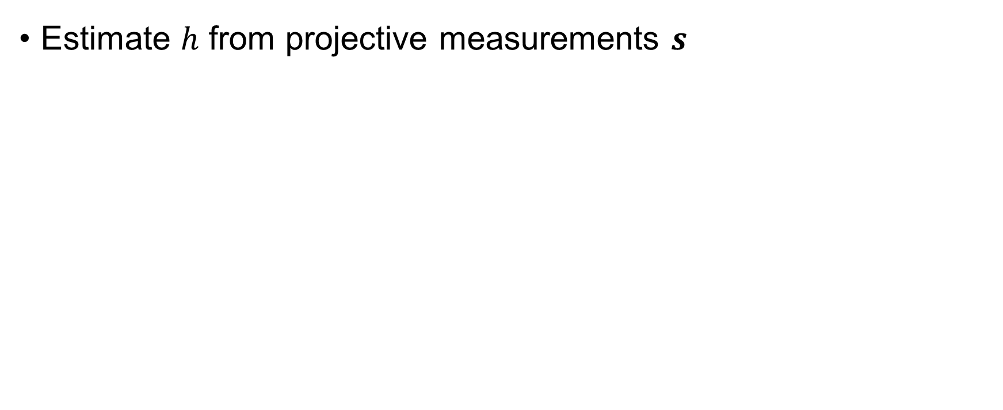
Predicting field strength
Estimate $h$ from projective measurements $s$
$$\tilde{h}={argmax}_{h}\sum_{k}{log[P\left(s_{k} | h\right)]}$$

Slide 15
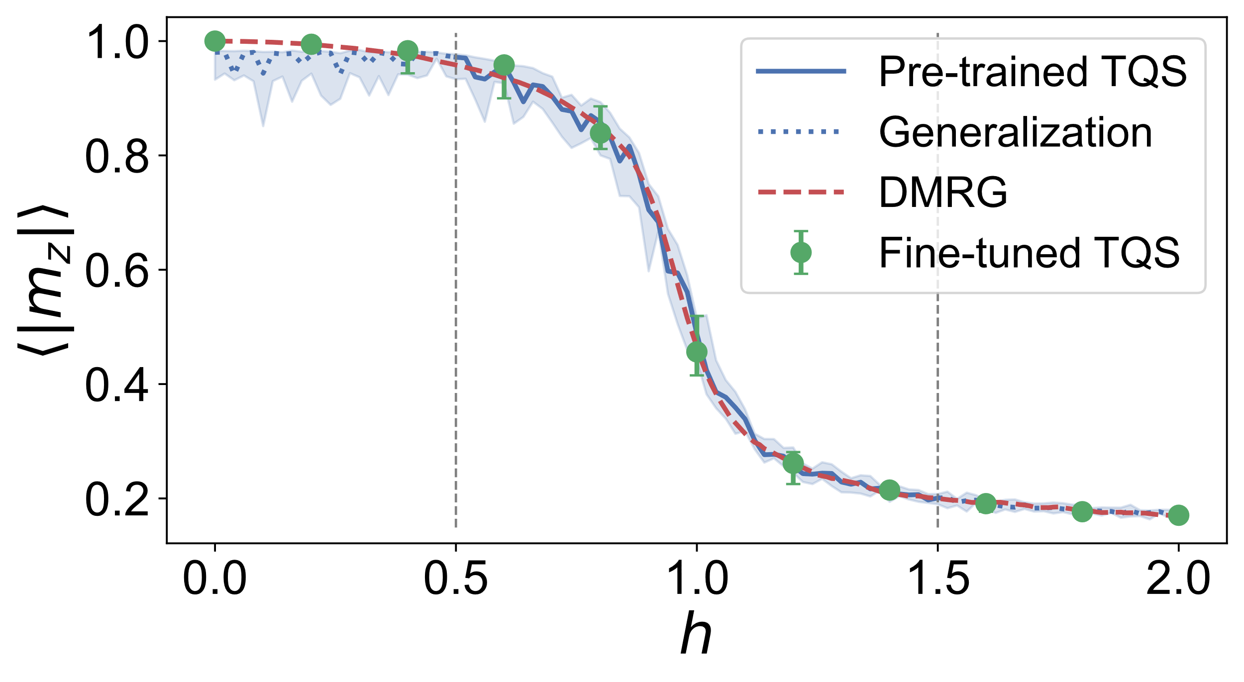

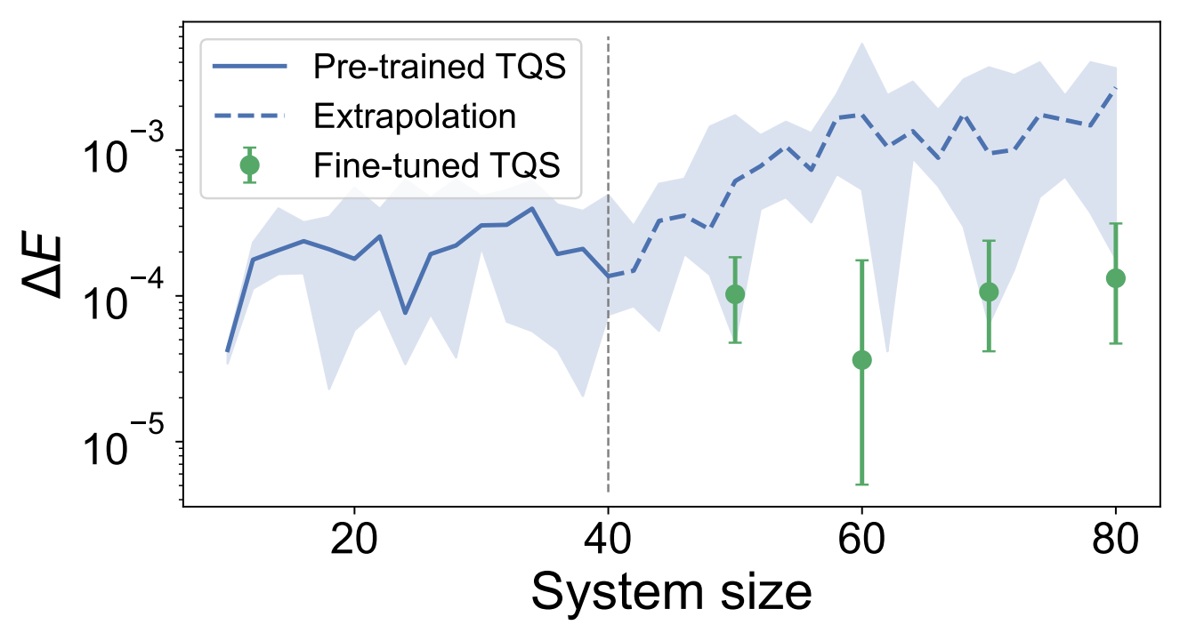
Conclusion
Family of quantum states
Phase diagram
Finite-size scaling
Parameter prediction
Knowledge transfer
All within one model!

Slide 16
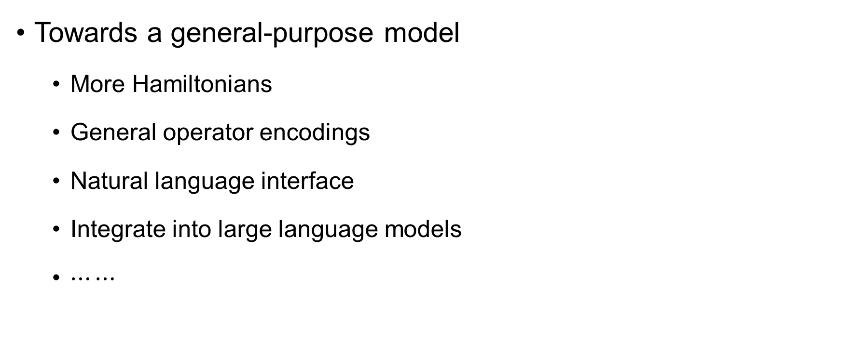
Future works
Towards a general-purpose model
More Hamiltonians
General operator encodings
Natural language interface
Integrate into large language models
$⋯⋯$

Slide 17
Thank you!
Y.-H. Zhang and M. Di Ventra
Phys. Rev. B 107, 075147 (2023)

